Slide 1
SQL PROJECT – Library management system
Liyon Sebastian
Data analytics
Edubridge india

Slide 2
Introduction
The Library Management System designed to help libraries efficiently manage their day-to-day operations. This system automates essential library functions such as cataloging books, tracking borrowing and returns, managing members, and overseeing inventory. By digitizing these processes, the system enhances the user experience for both library staff and members, while also improving resource management.
Key Features
1. Book Management
2. Member Management
.3. Borrowing and Returning
.4. Inventory Management
.5. Search Functionality
.6. Reporting and Analytics.

Slide 3
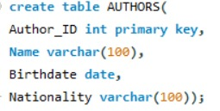
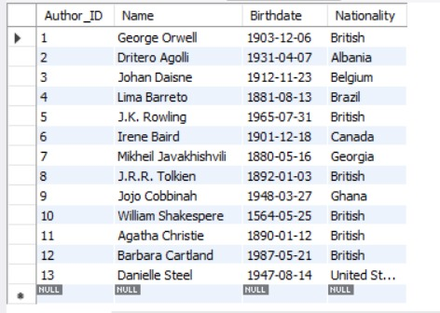
TABLE 1

Slide 4
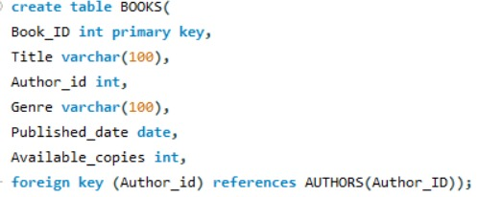
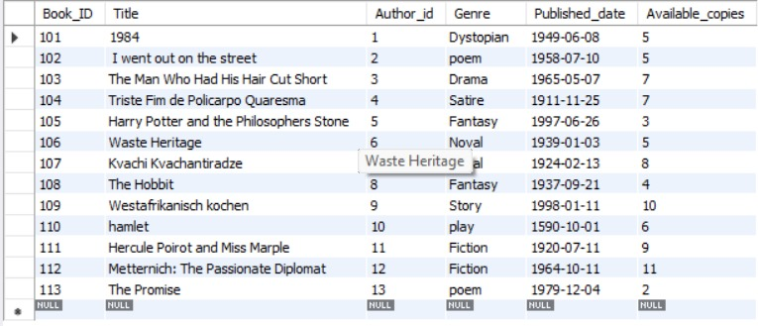
TABLE 2

Slide 5
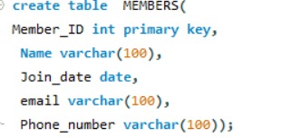
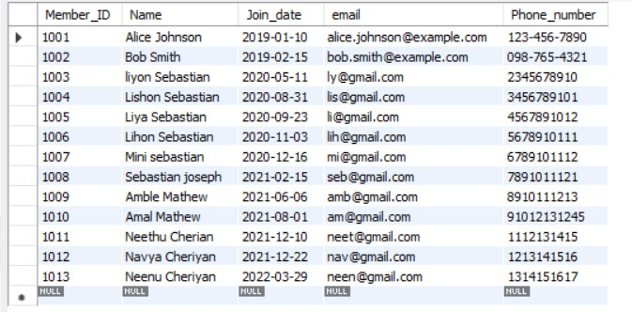
TABLE 3

Slide 6
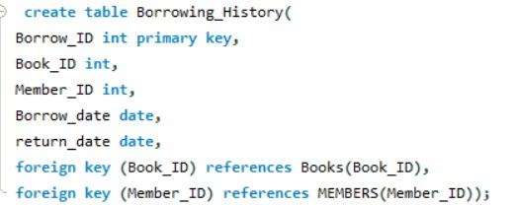
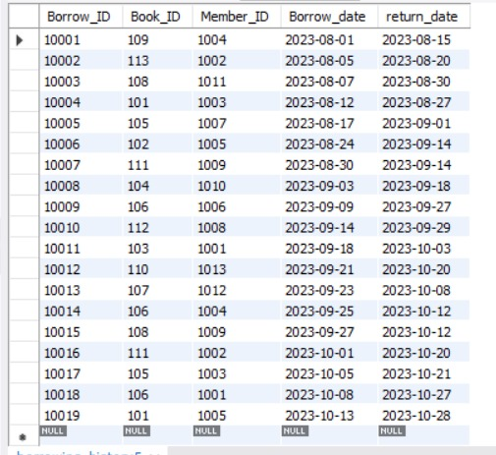
TABLE 4

Slide 7
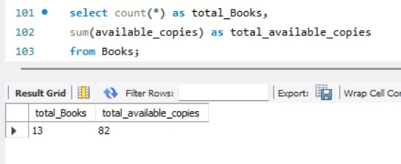
Counting total books and total copies

Slide 8
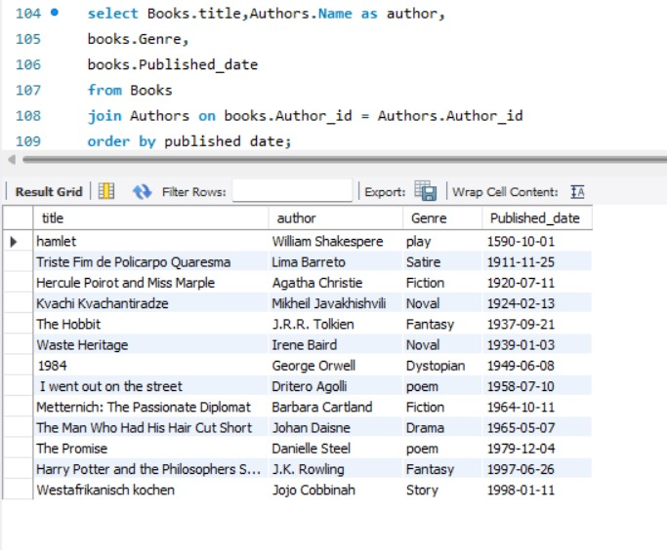
2. Listing the details of all books along with the name of their authors

Slide 9
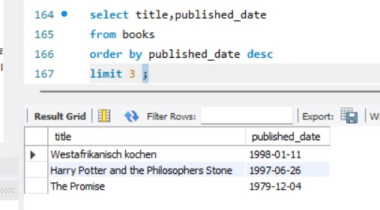
3. Finding the most recent book added to the library

Slide 10
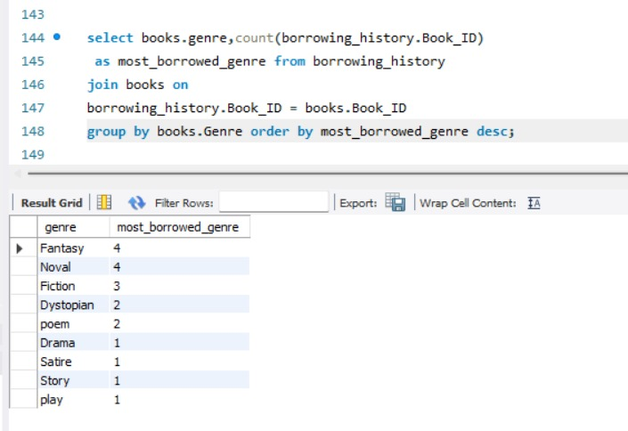
4. Finding the most borrowed genre.

Slide 11
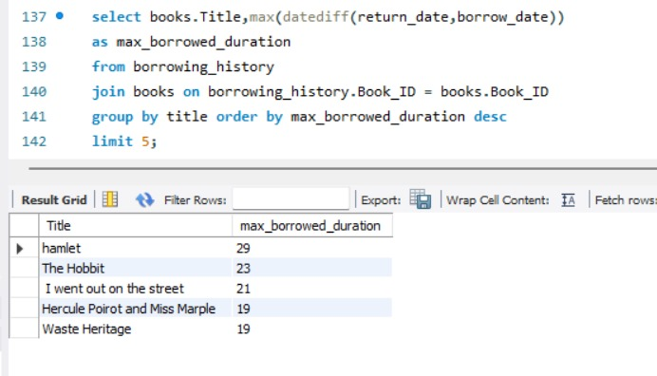
5. List of overdue books that haven’t returned on time (max 18 days).

Slide 12
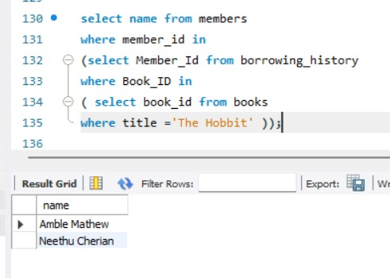
6. Find members who have borrowed 'The Hobbit'.

Slide 13
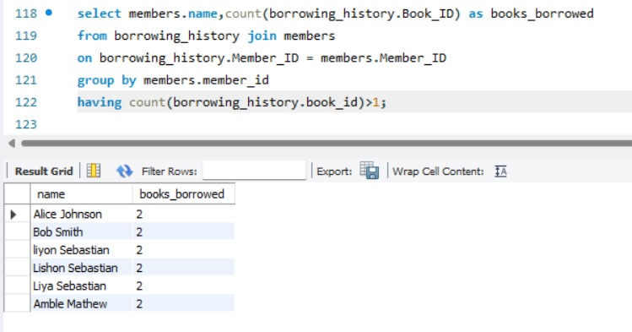
7. List the names of members who have borrowed more than one book in total.

Slide 14
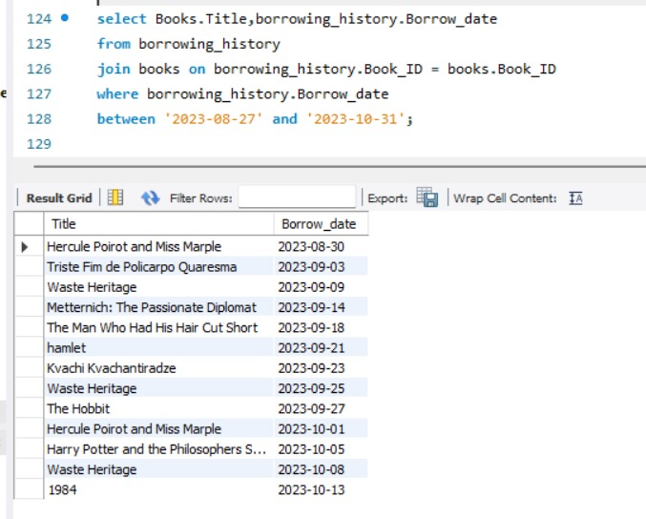
8. Find books borrowed within a specific date range (e.g., between ‘2023-08-20’ and ‘2023-12-31’).

Slide 15
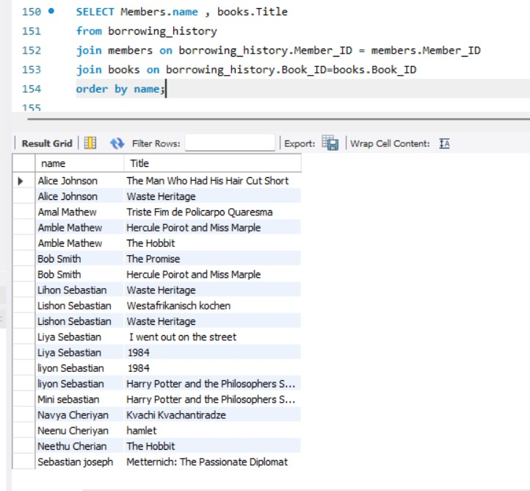
9.List of books borrowed by members

Slide 16
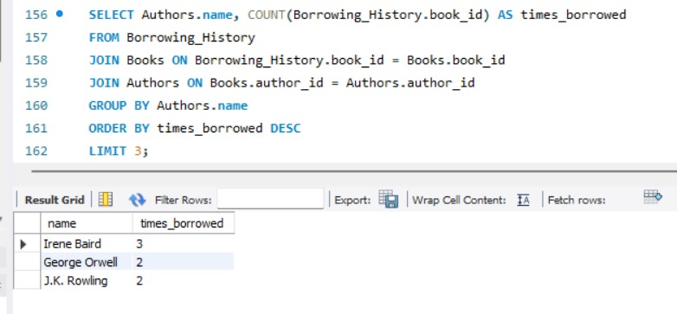
10. authors whose books were borrowed the most.

Slide 17
Conclusion
In conclusion, The system improves the overall experience for both librarians and members, offering easy access to book inventories, borrowing histories, and member details. Additionally, features such as search functionality and reporting provide valuable insights into library usage patterns, enabling better decision-making and resource allocation. The Library Management System streamlines library operations, increases efficiency, and fosters a more organized and user-friendly environment. It is an essential tool for modern libraries, helping them meet the growing demand for digital resource management and improving the accessibility of knowledge to the community

Slide 18
Thank you

